Slide 1
Practical Winlink
With
Gerry Brown KK7GAB & Craig Cherry N7RWB

Slide 2
What we will cover
Presentation
  What is WinLink
  Transports
  WWW Resources
  WinLink Express Application
Demo
  Download and Install VARA FM
    VARA FM Session
  MobiLinkD AX25 Session (If time available)

Slide 3
What is WinLink
WinLink is an ecosystem of Client and Server applications that allow us to send emails
over amateur radio.
They can be sent from/to ham radio accounts or Internet email accounts
It supports attachments such as pictures and forms within size limits.
Connections can be Point to Point or via Internet Servers.
It is controlled by a team of developers that work with ham radio operators to enhance
the products as new technologies are developed. Updates are automatic through the
different applications that make up the ecosystem
Today we concentrate on “WINLINK EXPRESS”, the standard Windows client application.

Slide 4
What are the Transports We Use?
Think of a transport as how we get from point A to point B.
When we go to the store we can:
1) Walk
2) Ride a bike
3) Take a bus
4) Drive a car
Similarly, we can use different transports to connect to WinLink Servers,
known as RMS (Remote Message Servers)
Some are slower and some are faster (technological advances)
Today we will discuss two transport mechanisms
AX25 and VARA
They require the use of a “soundcard” The soundcard changes the data into
tones that can be transmitted/received on amateur radios.

Slide 5
AX25
Originally developed in the 1970s for amateur radio.
Based on the successful X.25 protocol used in data communications.
It supports packetization, and windowing:
Packets are fixed length objects with error detection
Windowing allows a numbering system of fixed size windows
e.g. Here is packet 4. The last received was packet 2.
Thus, if the other side had sent 3 packets, it would
know that the 3rd one wasn’t received correctly and could
retransmit it.
VARA FM
Developed in 2020 by a Spanish programmer.
It uses packets and windows. BUT it adds signal processing techniques to
improve weak signal operation and digipeaters.
It is proprietary and requires a one time fee of $75 to use at full speed.
(Source code is held in an Escrow Account)

Slide 6
Comparative
Transport Speeds
Mode | Typical Throughput
AX.25 (1200) | 300–600 bps
AX.25 (9600) | 2–4 kbps
VARA FM (PAID) | 5–20 kbps
VARA HF (PAID) | 1–7 kbps (adaptive)
PACTOR 3/4 | 3–10+ kbps
In 2024, the FCC allowed for faster digital symbol rates leading
to faster VARA and PACTOR 4

Slide 7
TNCs Terminal Node Controllers
A KISS TNC converts digital data to sounds. Also known as a SoundCard
The ones we use:
AX25: Kantronics KPC3+
MobiLinkD
VARA: Masters Communicatioms DRA-50M
Tigertronics SignaLink USB

Slide 8
C
Computer
WinLink
Express
Transport
Vara/AX25
TNC
SoundCard
Amateur
Radio

Slide 9
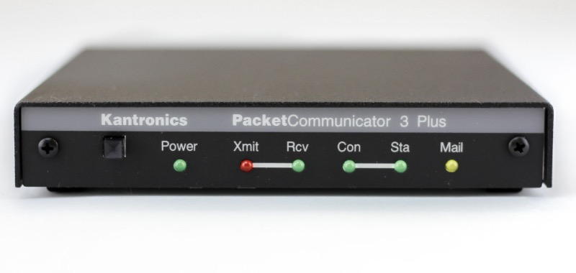
Kantronics KPC3+ for AX25
Kantronics KPC3+ $249
10 Pin Yaesu Cable $ 70
Total $319

Slide 10
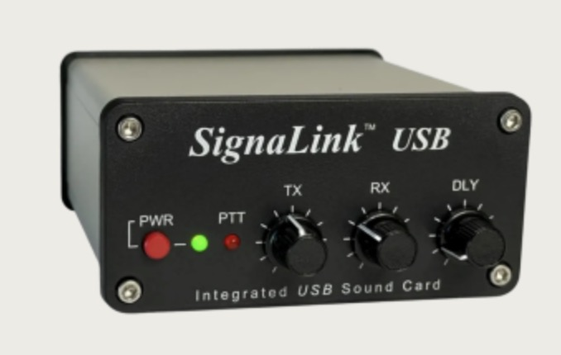
Common TNC for VARA
Tigertronics SignaLink USB
SLUSB6OM $120
Jumper Block $ 9
Total $129

Slide 11
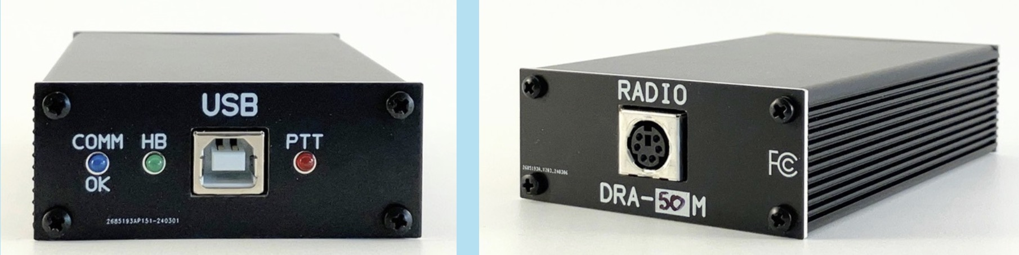
DRA-50M for VARA
Masters Communications DRA-50M
DRA-50M $115
DIN6 Cable $ 10
Yaesu CT-164 (Yaesu tax) $ 48
Total $173

Slide 12
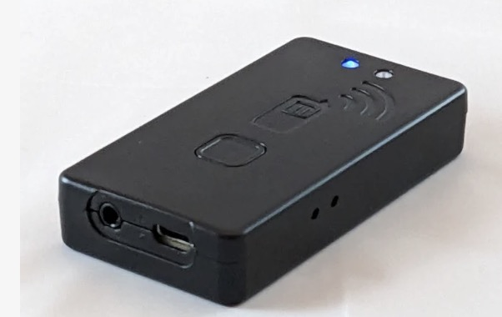
Common HT TNC for AX25
MobiLinkD TNC4
TNC4 $150
Radio Cable (FT-60) $ 10
Total $160

Slide 13
WINLNK ON THE WEB
https://www.winlink.org
or simply
winlink.org

Slide 14
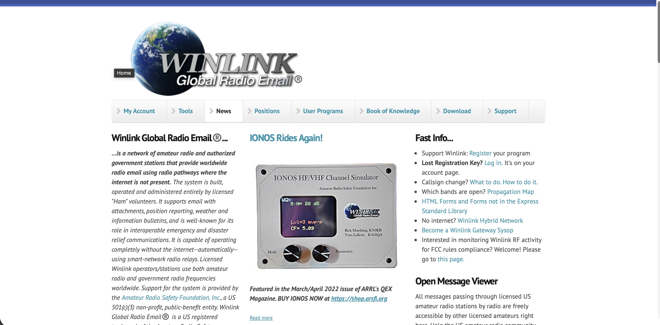
Winlink.org

Slide 15
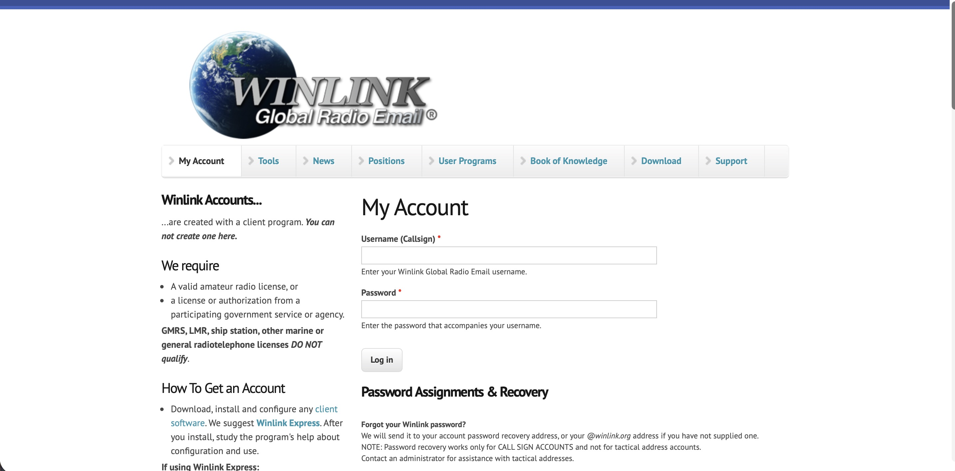

Slide 16
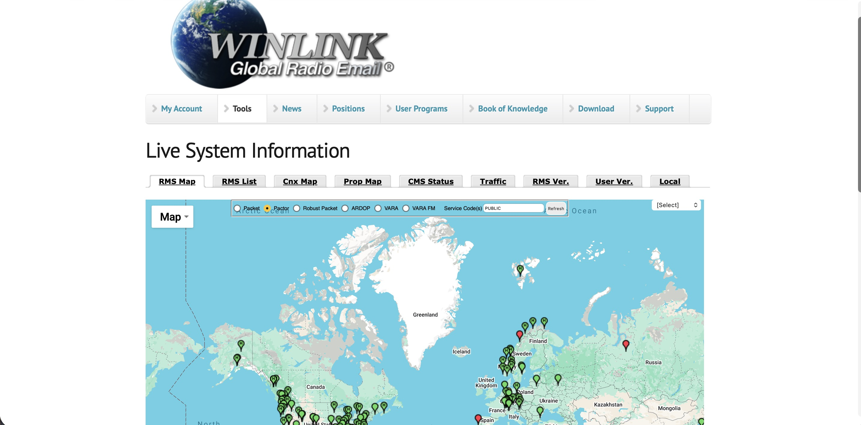

Slide 17
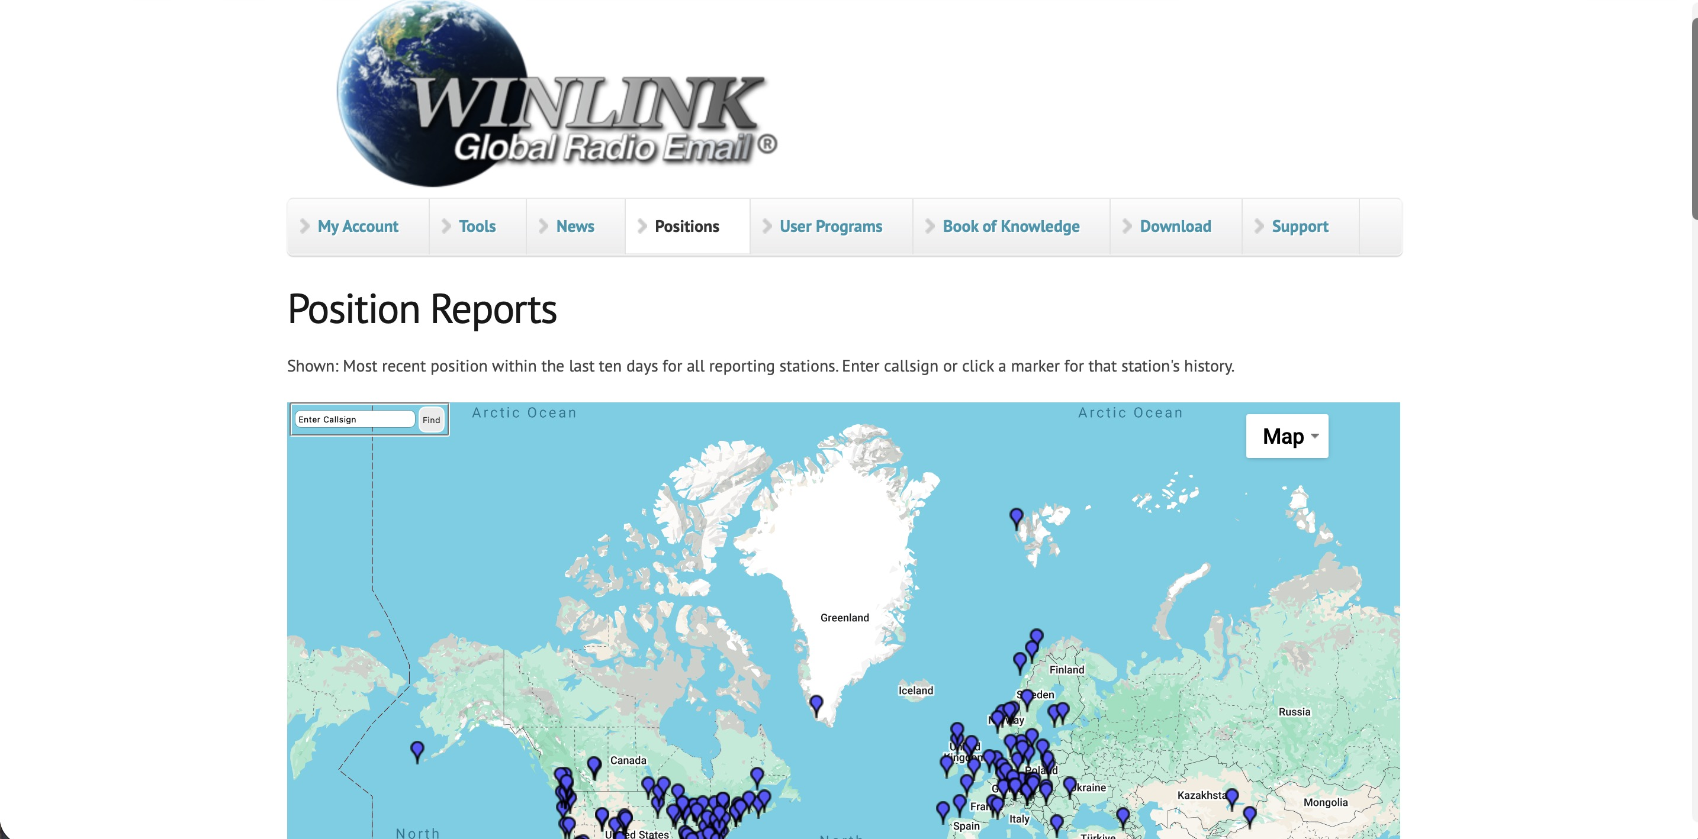

Slide 18
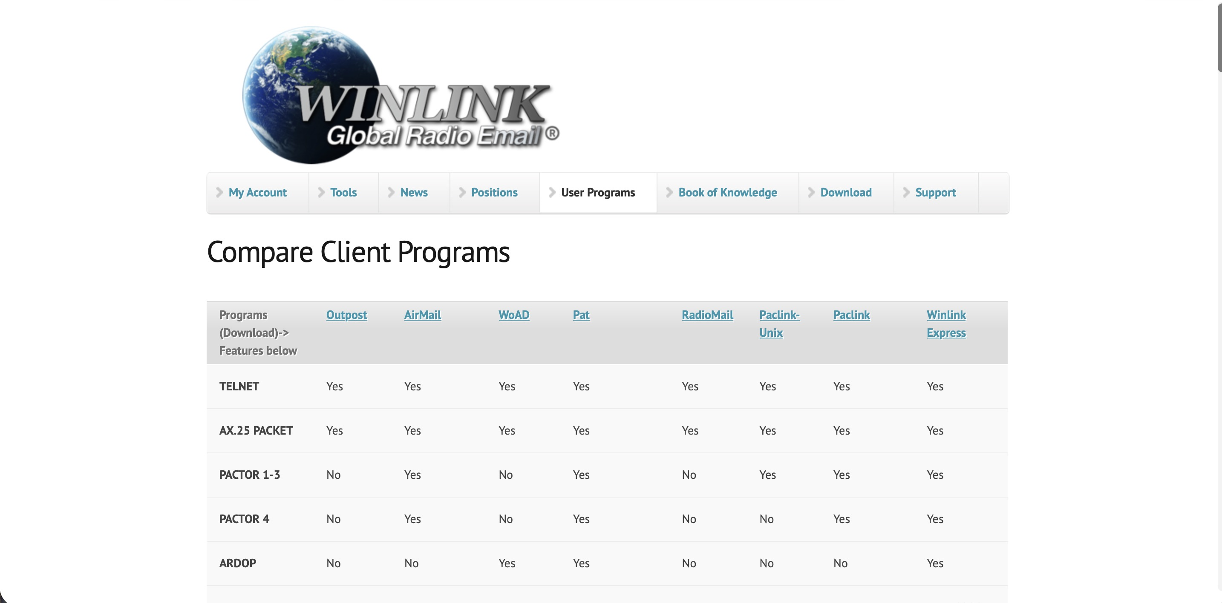

Slide 19
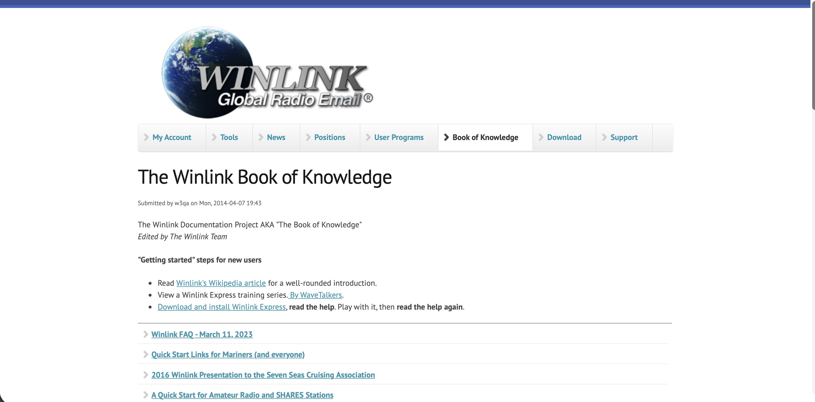

Slide 20
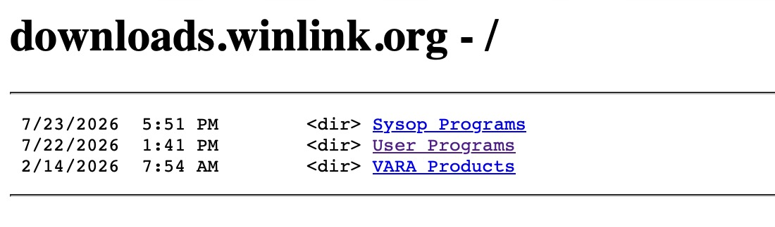
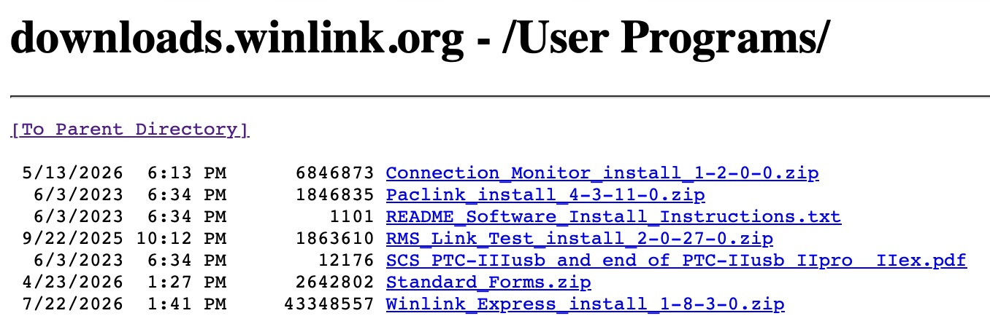
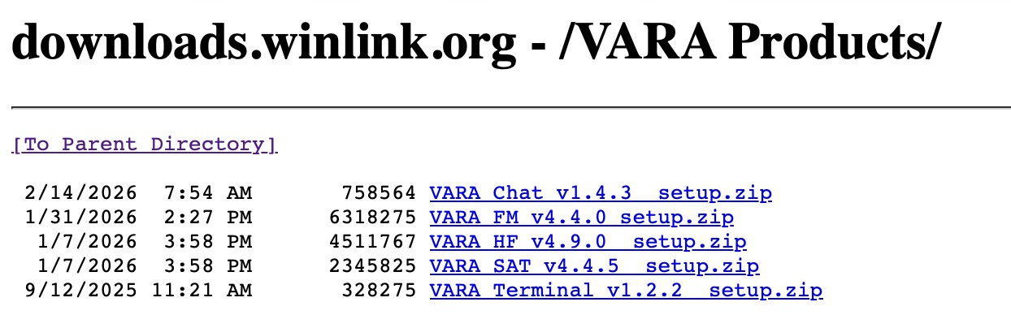

Slide 21
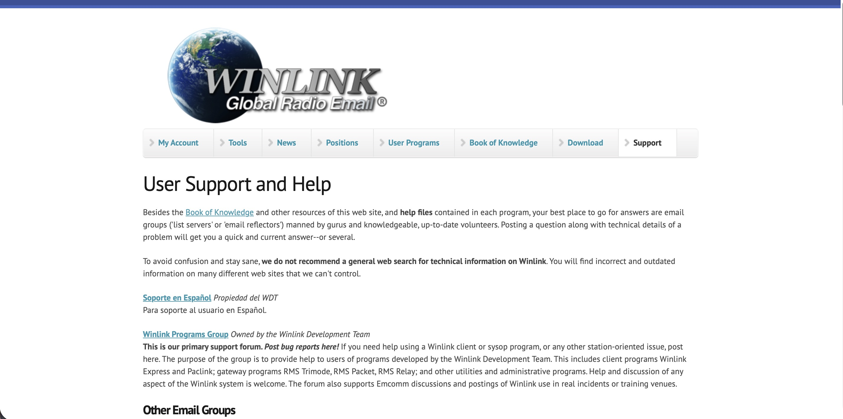

Slide 22
Another important website
https://emcomm-training.org/Winlink_Thursdays.html

Slide 23
Winlink Express application
Previously known as:
Winlink 200 or RMS Express
Download from Winlink.org
Expand the ZIP file
Run as Administrator
Installs into C:/RMS Express
Run it
Agree to License Agreement

Slide 24
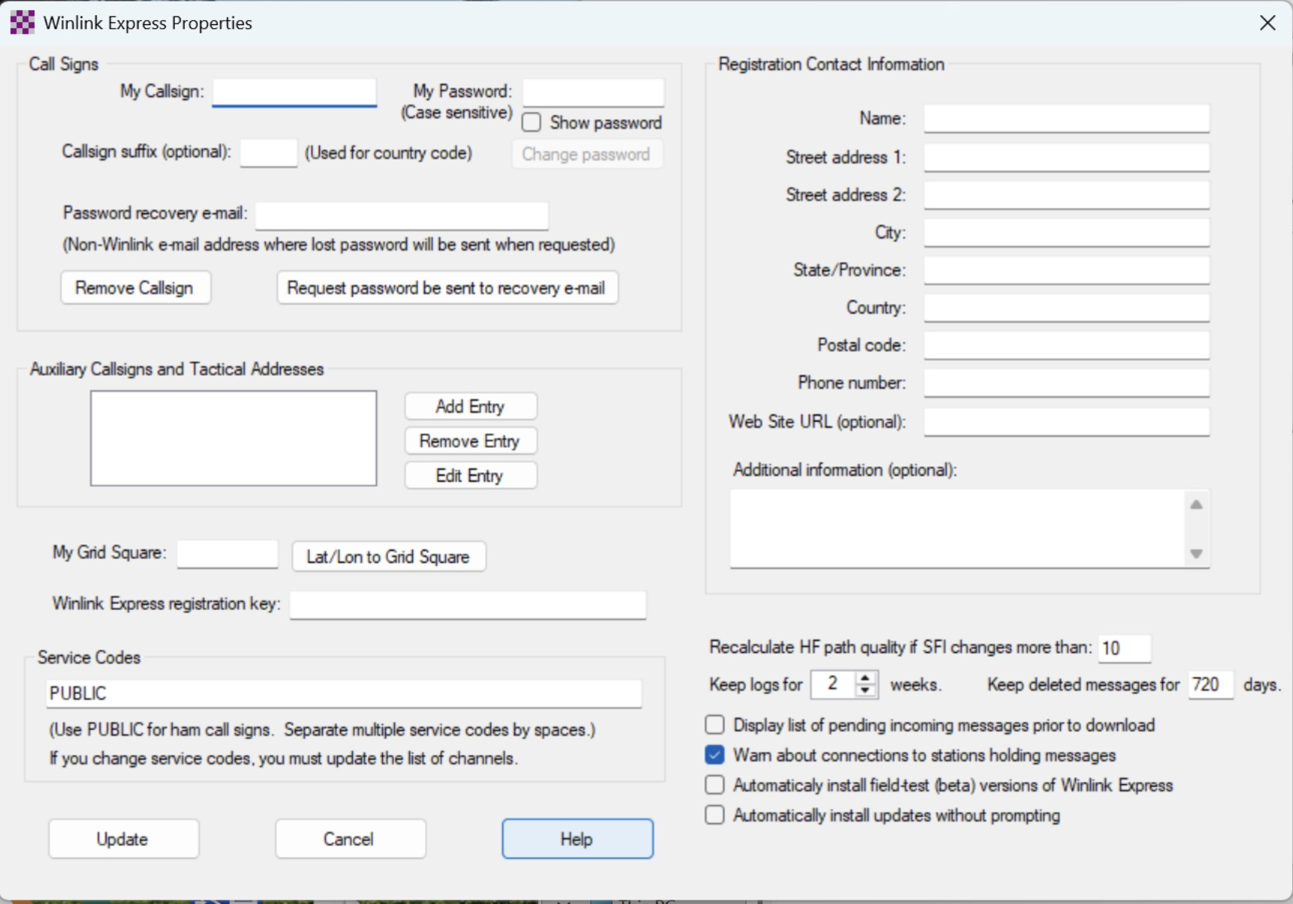

Slide 25
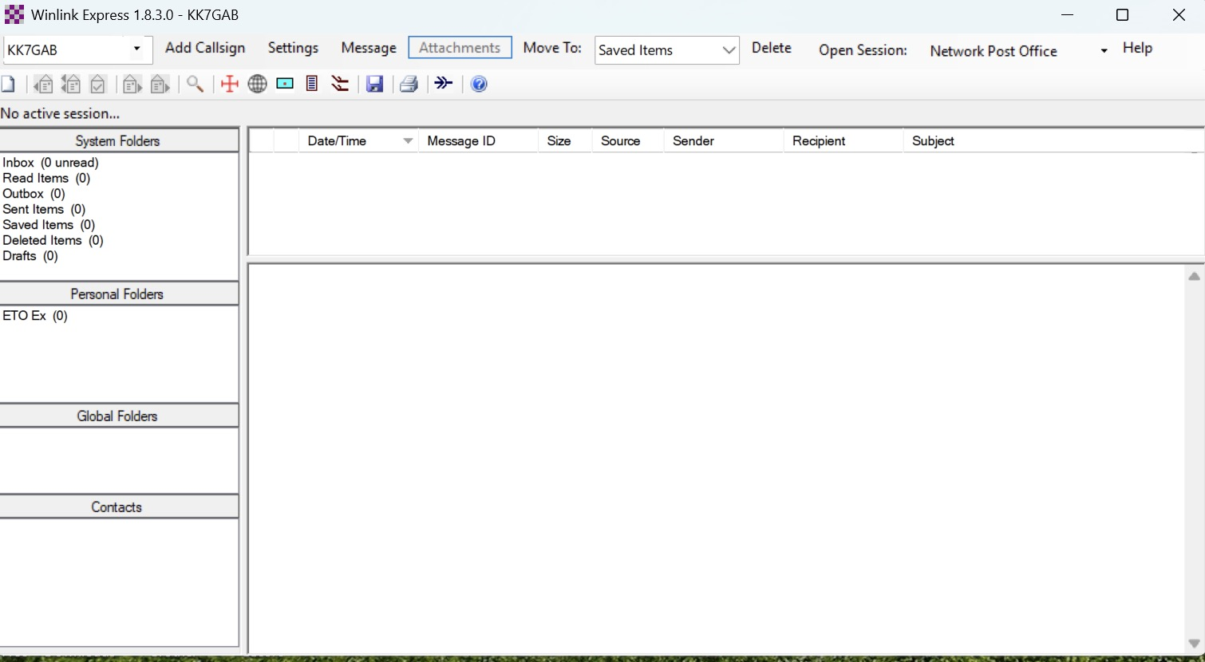

Slide 26
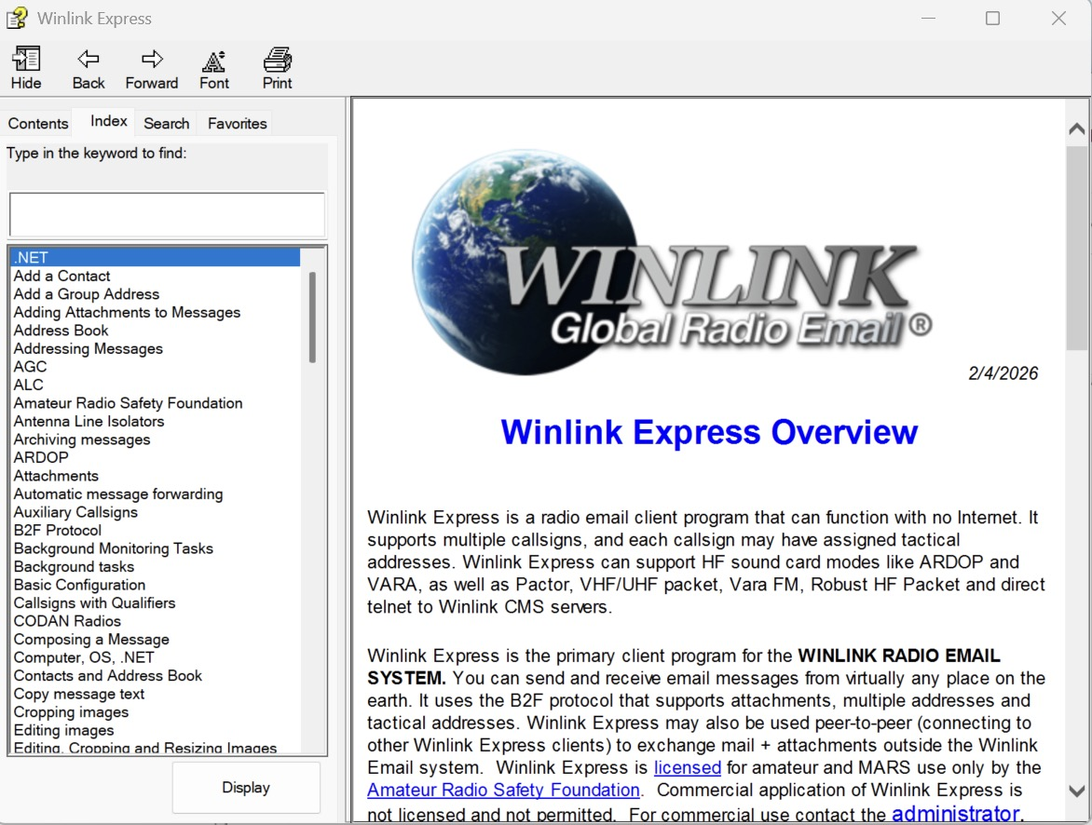

Slide 27
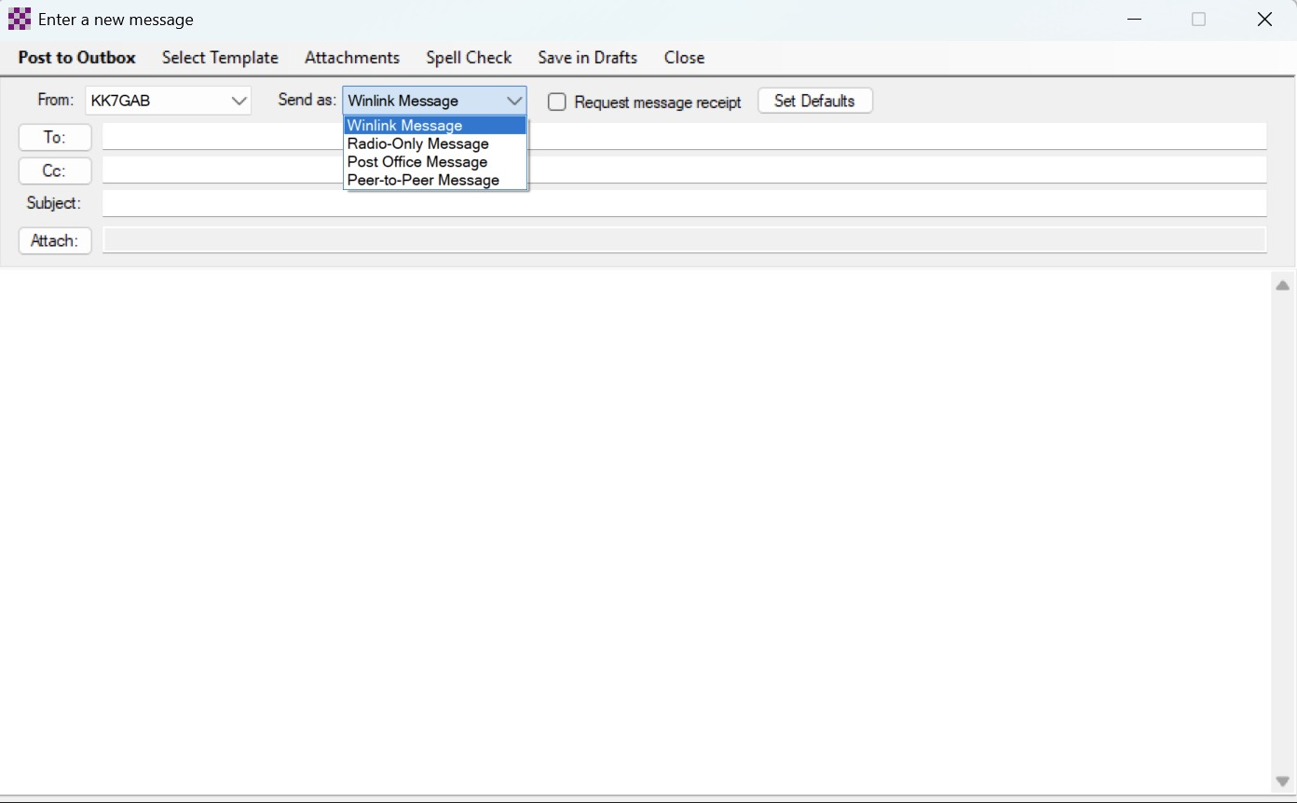
Creating a Winlink Message
From the Message Menu
Select New Message

Slide 28
Message Types
Winlink Message
  Sent normally through an RMS Gateway
Radio Only Message
  Can only be sent/received over ham radio
Post Office Message
  Station stays online and receive messages
    Message sent to Post Office are kept
    Receiver must log in to retrieve
Peer-to-Peer Message
  Both stations are online
  One side connects (via callsign) to the other
    Once connected, messages are transferred

Slide 29
Addressing messages
The “TO” field can either be a callsign or an Internet Address
An Internet Address is of the form <a>@<domain>
RECEIVING ADDRESSES
In order to limit SPAM, Winlink implements an ACCEPTLIST for Internet Addresses.
There are two ways to get an Internet Address in the ACCEPTLIST
1) send a Winlink email to that address
2) Edit the ACCEPTLIST on Winlink.org

Slide 30
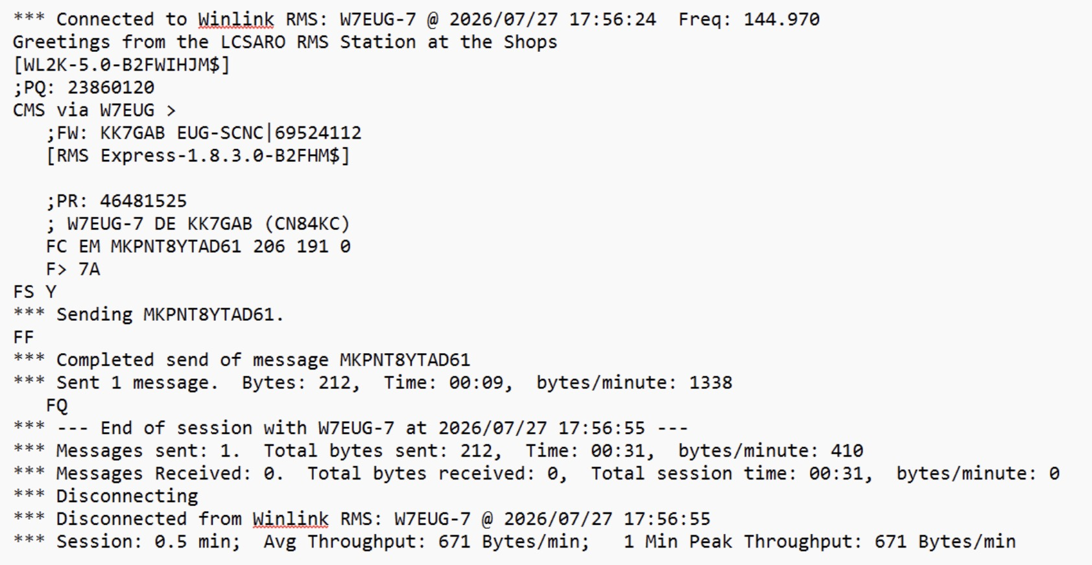
Symbol meanings can be found on the Winlink.org FAQ

Slide 31
VARA FM
VARA FM (used for VHF/UHF)
available on the WinLink.org -> Download -> VARA Products page
Download and install as administrator
It’s worth it to pay for the software
One time fee
Cost is now US$75

Slide 32
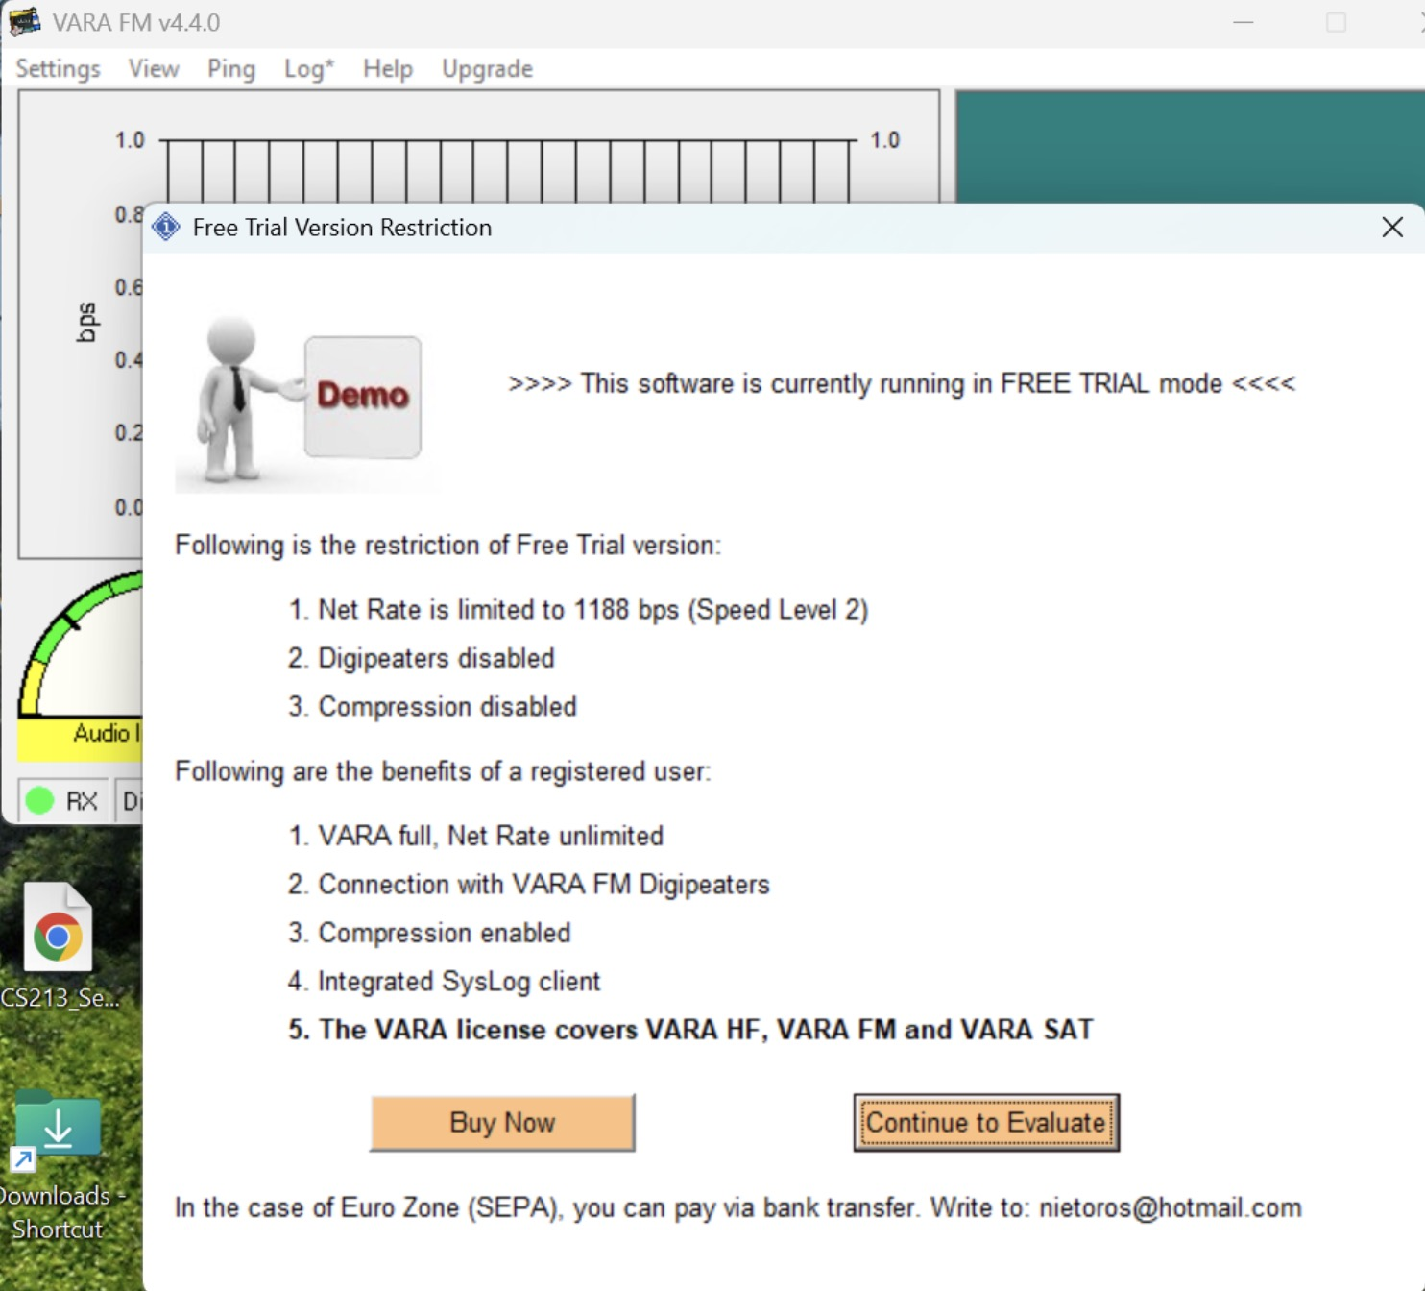

Slide 33
EUGENE AREA AX25 & VARA FM PACKET NODES
AX25
 | Name | Frequency | {Digipeater} | Location
 | W7EUG-10 | 145.030MHz | WALKER (W7SLA-1) | Courthouse
VARA FM
 | Name | Frequency | {Digipeater} | Location
 | W7EUG-7 | 145.970MHz | W7FLO-1 W7FLO-9 | County Shops
 | W7EUG-8 | 145.970MHz | W7FLO-1 W7FLO-9 | Courthouse
Use the Digipeater (in the “via” field) if you can not “reach” node.

Slide 34
DEMONSTRATION

